Slide 1
The Benefits of AI
Artificial intelligence is reshaping how businesses operate — delivering faster results, sharper accuracy, and smarter decisions at scale.

Slide 2





OVERVIEW
Five Ways AI Transforms Business
From routine tasks to strategic innovation, AI delivers measurable impact across every layer of an organization.
Saves Time
Improves Accuracy
Automation
Automates repetitive work
Reduces human error
Scales operations effortlessly
Decision Making
Innovation
Data-driven insights
Unlocks new possibilities

Slide 3
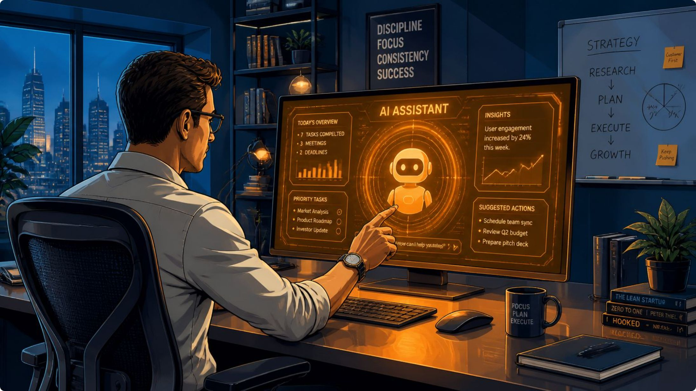

BENEFIT 1
AI Saves Time
AI handles the tasks that consume hours of your team's day — data entry, scheduling, report generation, and more — freeing people to focus on high-value work.
Faster Processing
24/7 Availability
AI analyzes documents and datasets in seconds, not hours.
Unlike human teams, AI systems never stop working.

Slide 4
BENEFIT 2
AI Improves Accuracy
Minimize Errors, Maximize Confidence
Human error costs businesses billions annually. AI systems maintain consistent precision across repetitive, data-intensive tasks — from financial reconciliations to medical diagnostics.
Detects anomalies humans routinely miss
Applies the same standard every time
Continuously learns and improves

Slide 5



BENEFIT 3
Automation at Scale
AI-powered automation doesn't just speed things up — it redefines what's possible. From customer service chatbots to supply chain optimization, automation scales without scaling headcount.
Identify
Spot repetitive, rule-based tasks
Automate
Deploy AI workflows and agents
Optimize
Monitor, refine, and scale

Slide 6
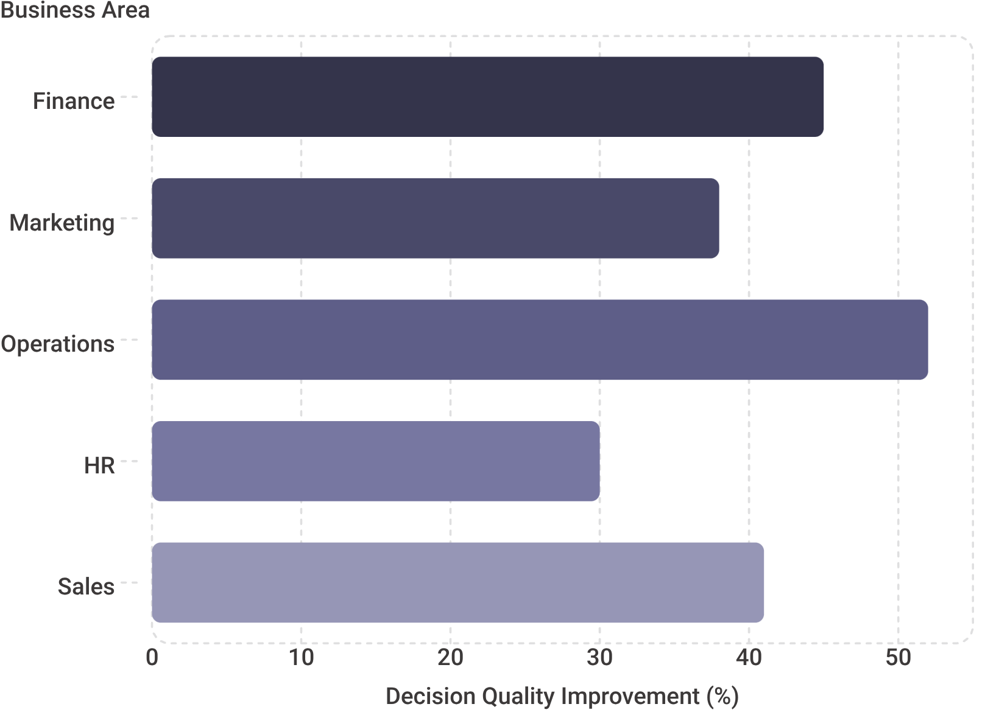
BENEFIT 4
Smarter Decision Making
Data-Driven Clarity
AI transforms raw data into actionable insights, helping leaders make faster, more confident decisions backed by evidence — not instinct alone.
Predictive analytics surface trends early
Real-time dashboards replace guesswork
Scenario modeling reduces risk

Slide 7



BENEFIT 5
AI Fuels Innovation
The most transformative benefit of AI isn't efficiency — it's the ability to imagine and build what wasn't possible before. AI accelerates R&D, personalizes products, and opens entirely new business models.
Accelerated R&D
New Business Models
Competitive Edge
AI compresses years of research into months, from drug discovery to materials science.
AI-native products and services create revenue streams that didn't exist before.
Organizations leveraging AI innovate faster and capture market share ahead of competitors.

Slide 8

The Bottom Line
AI isn't a single tool — it's a multiplier across every dimension of your business. Organizations that embrace it strategically gain compounding advantages.
40%
3x
Time Saved
Faster Decisions
On average, across automated workflows
Compared to manual analysis
62%
5+
Cost Reduction
Core Benefits
In automated operational processes
Across time, accuracy, automation, decisions, and innovation
The question isn't whether to adopt AI — it's how quickly you can integrate it into your strategy.

